Slide 1
Freight Analysis Framework

Slide 2
What is FAF?

Slide 3
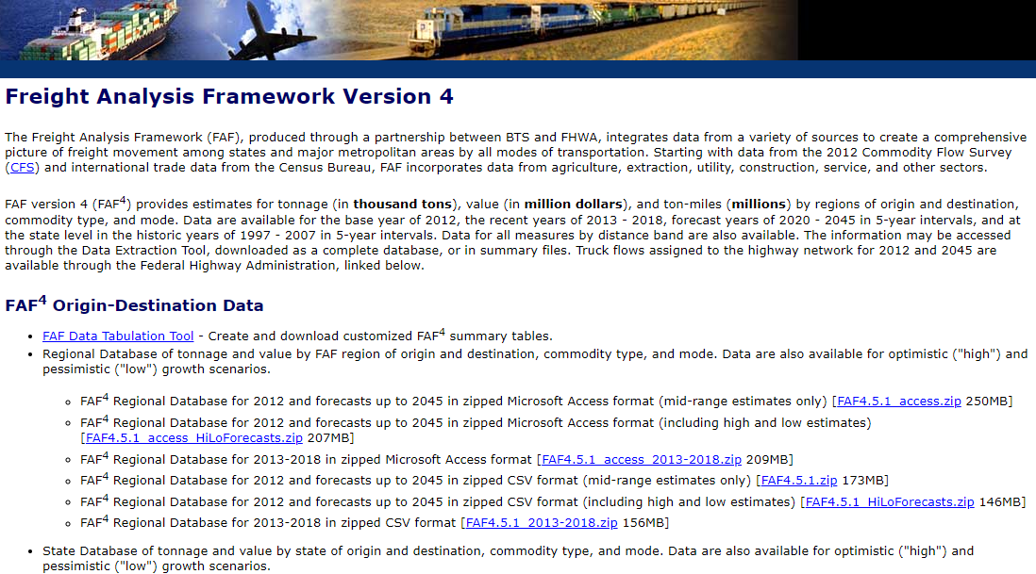

Slide 4
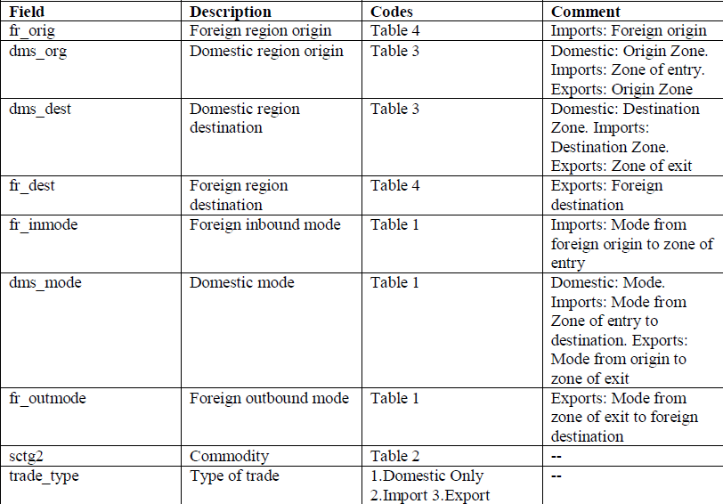

Slide 5
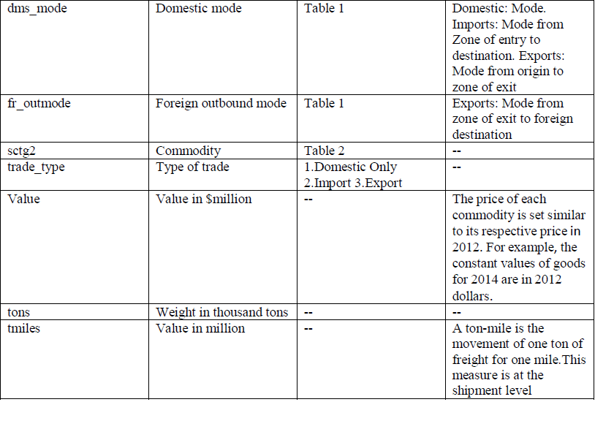

Slide 6
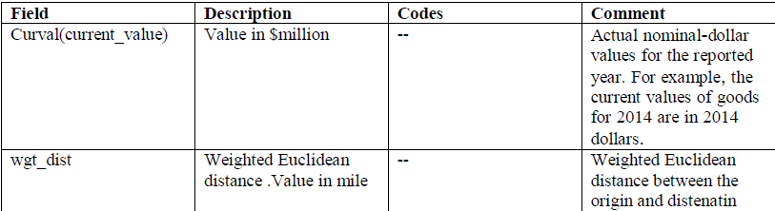

Slide 7
Data Exploration

Slide 8
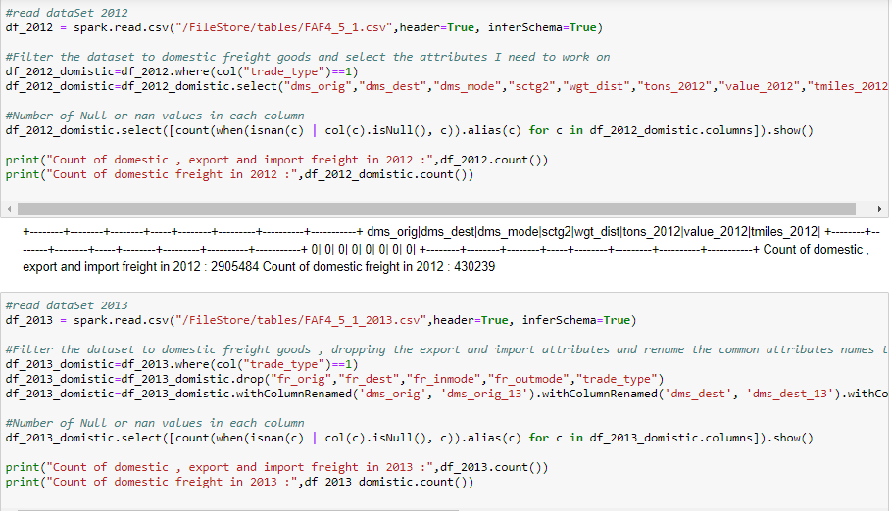

Slide 9
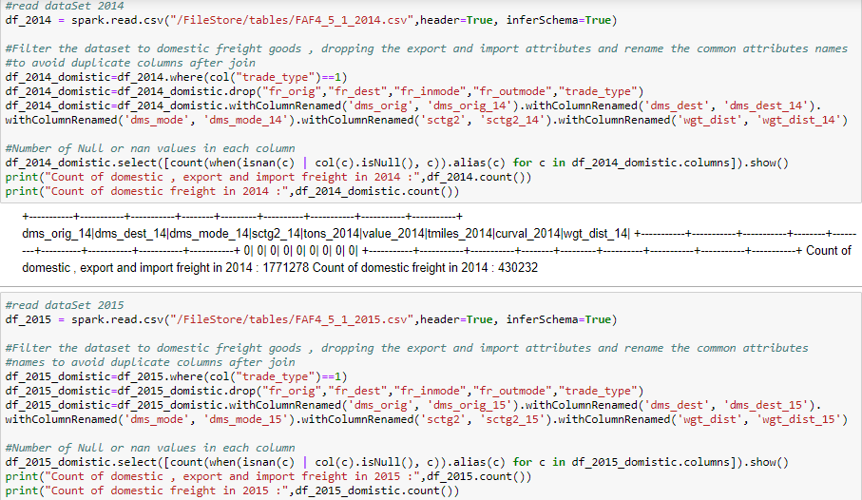

Slide 10
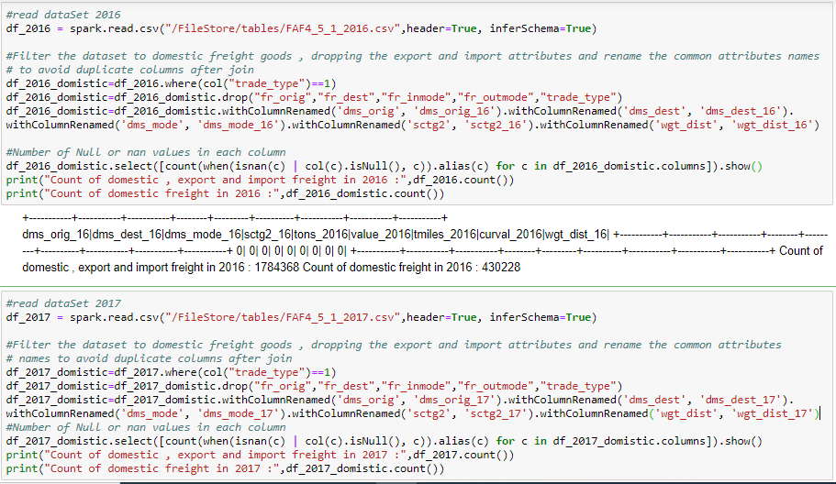

Slide 11
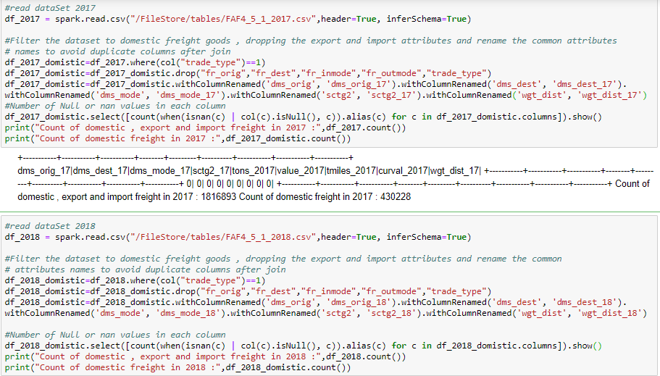

Slide 12
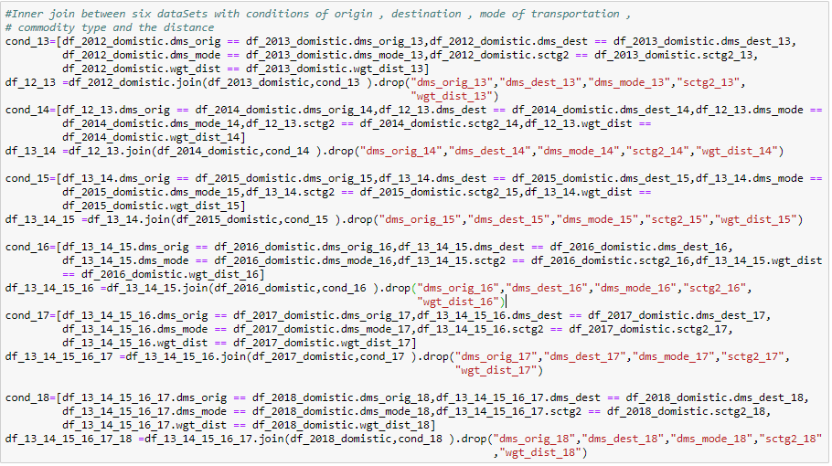

Slide 13
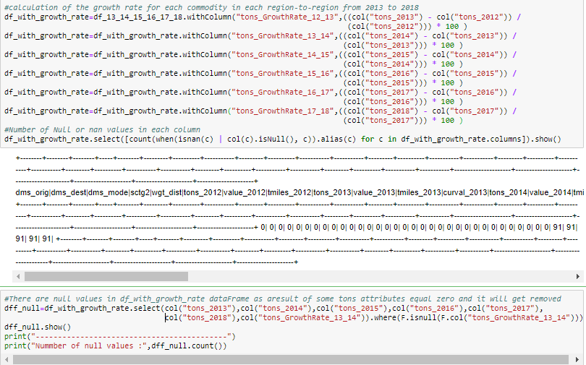

Slide 14
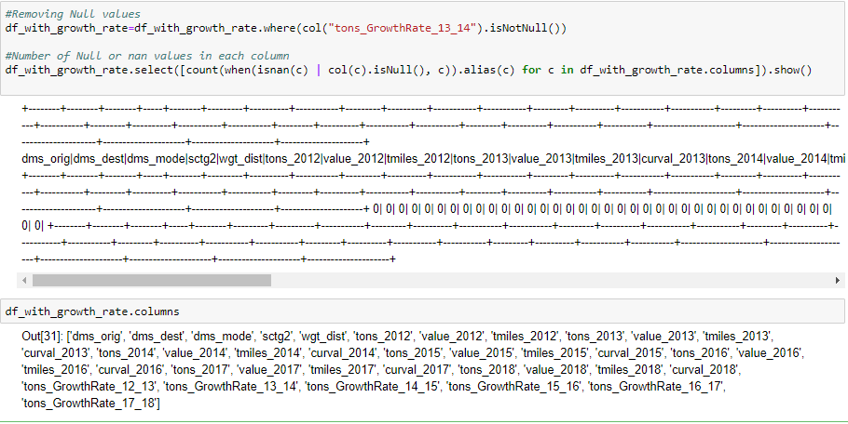

Slide 15
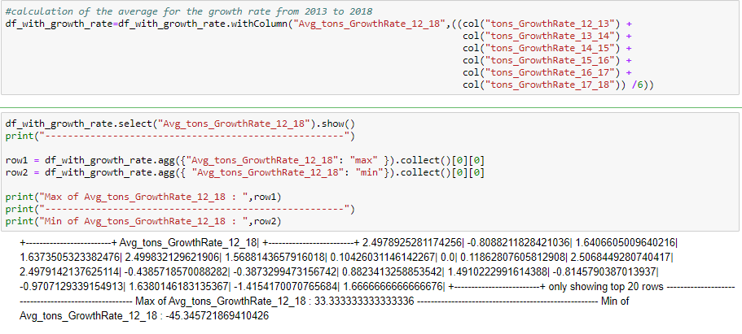

Slide 16
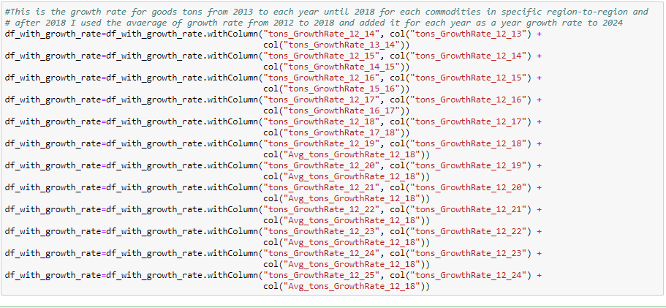

Slide 17
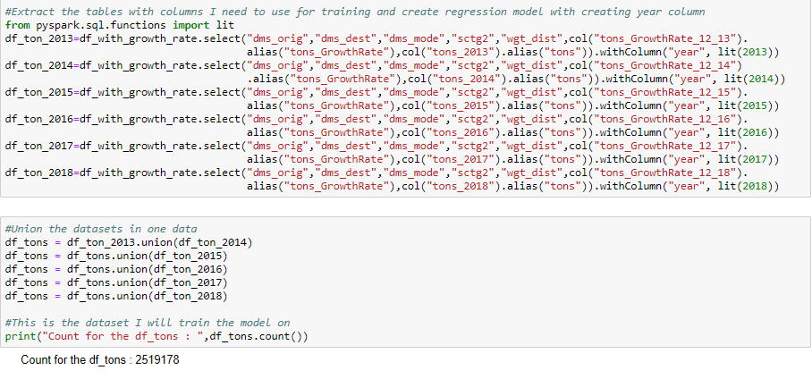

Slide 18
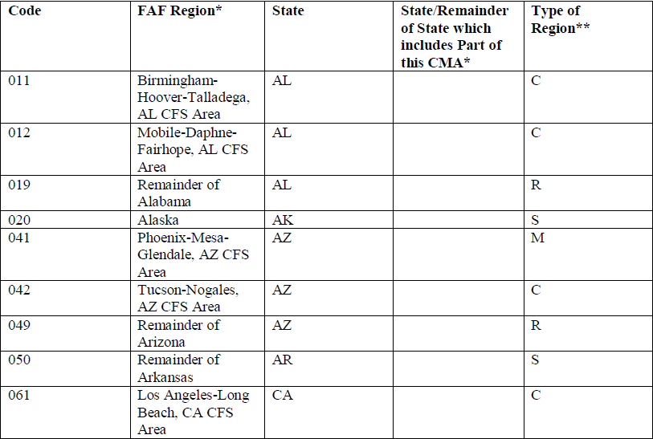

Slide 19
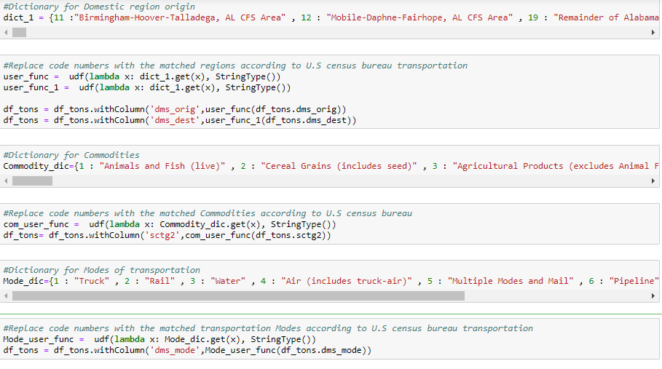

Slide 20
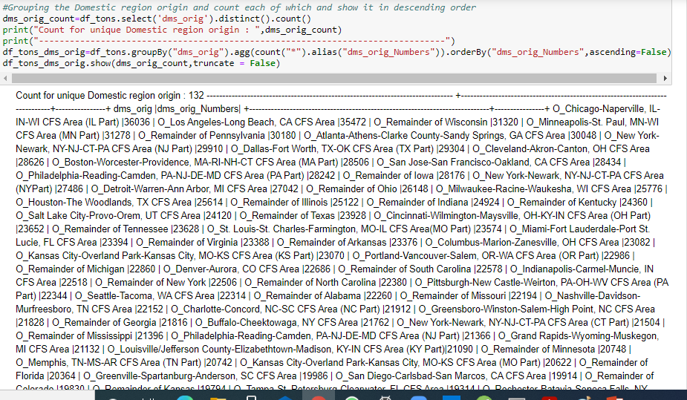

Slide 21
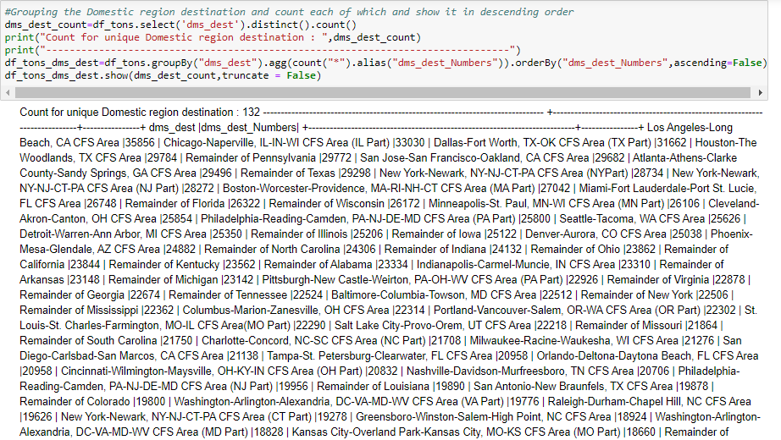

Slide 22
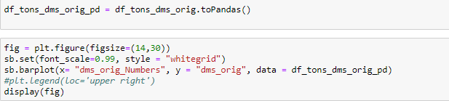

Slide 23
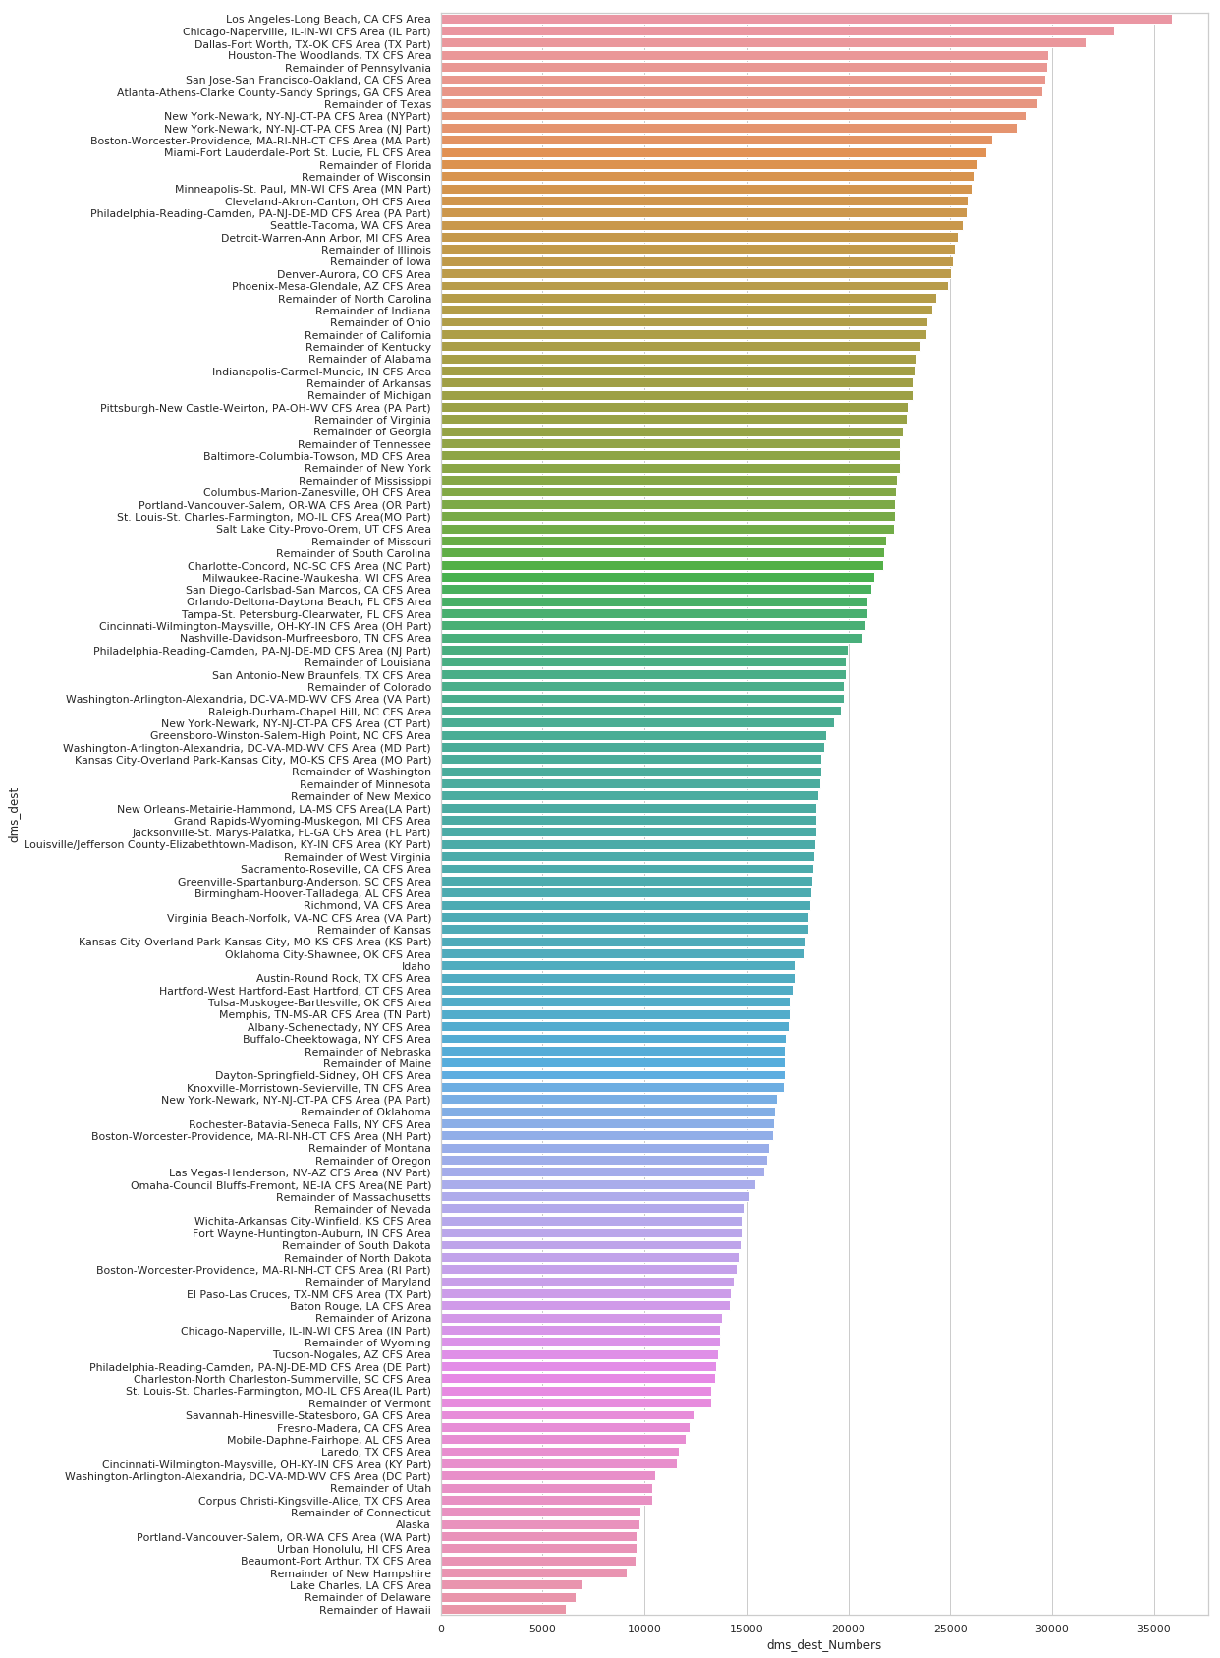
Domestic Destination

Slide 24
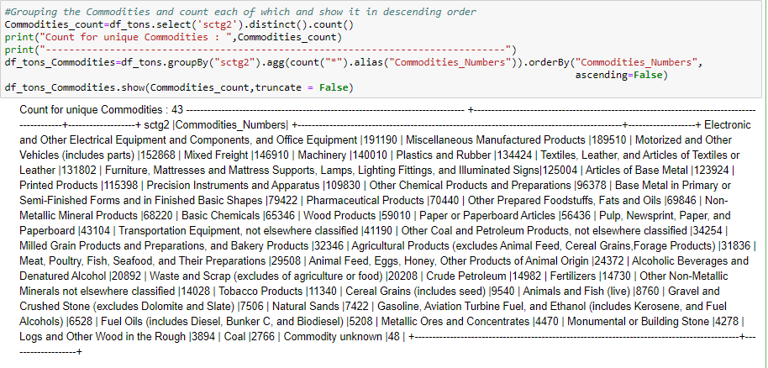

Slide 25
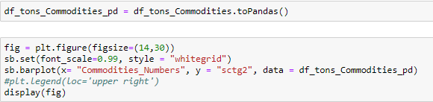

Slide 26
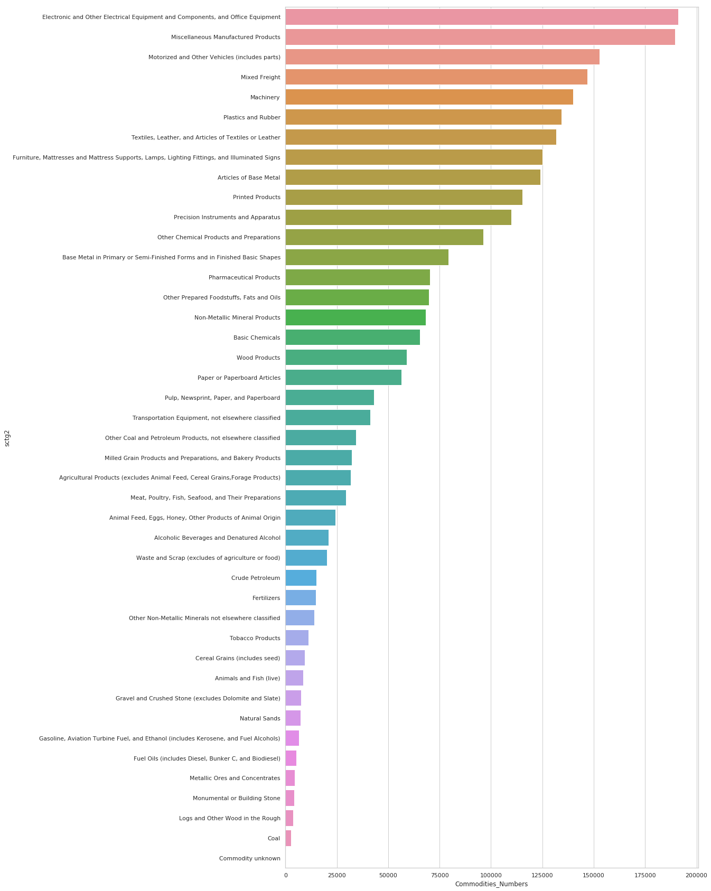
The Commodities

Slide 27
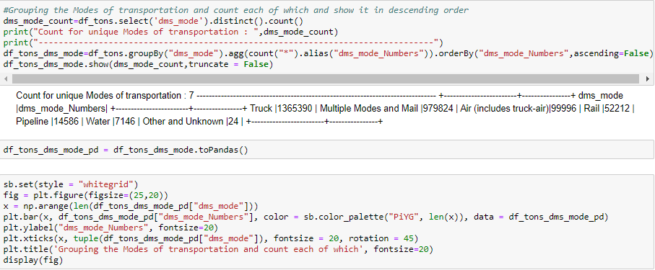

Slide 28
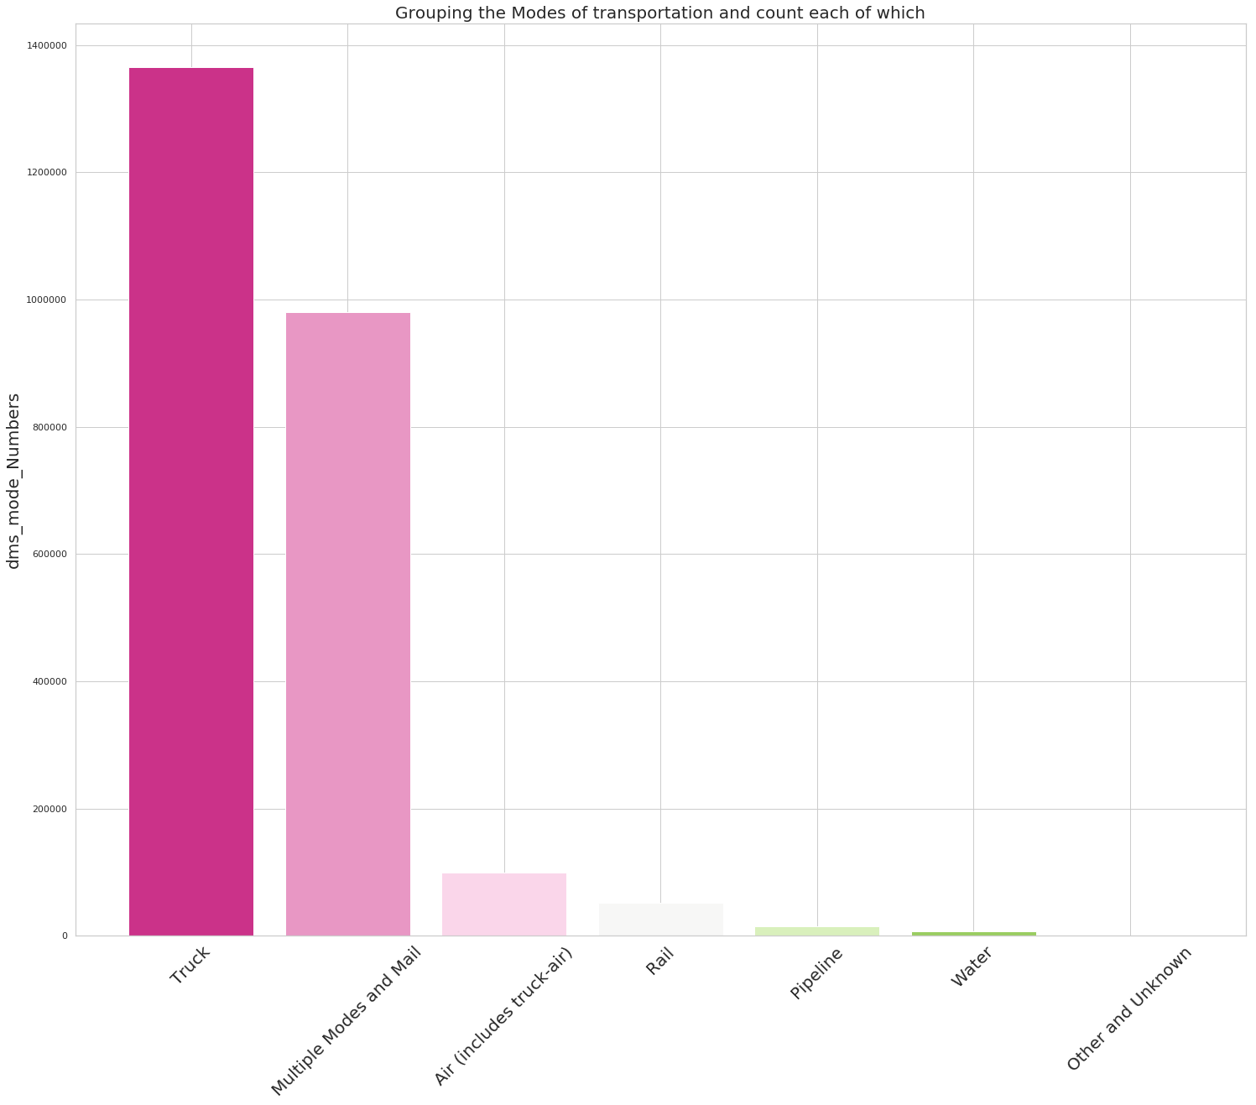
Domestic Modes

Slide 29
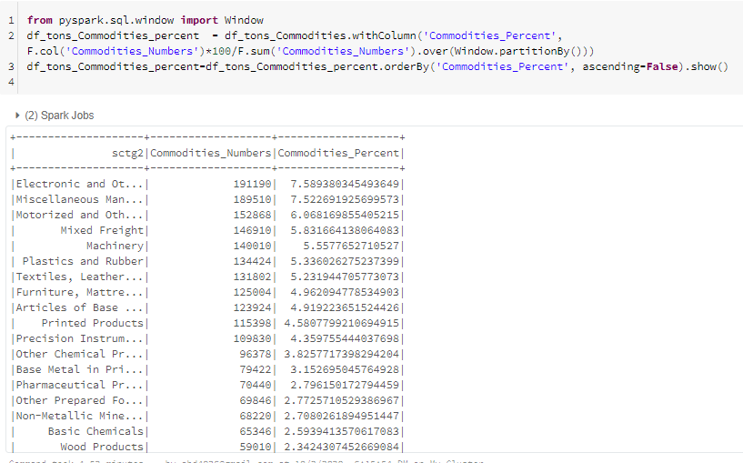

Slide 30
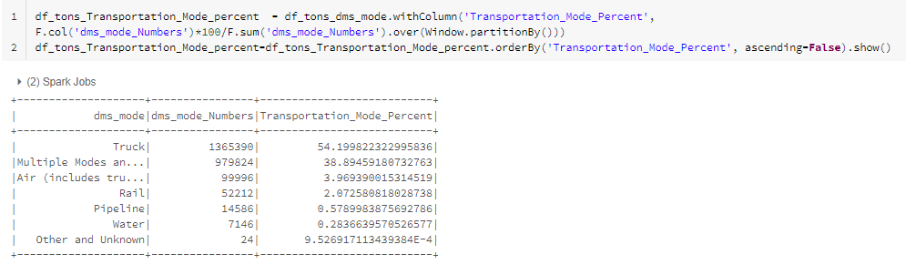

Slide 31
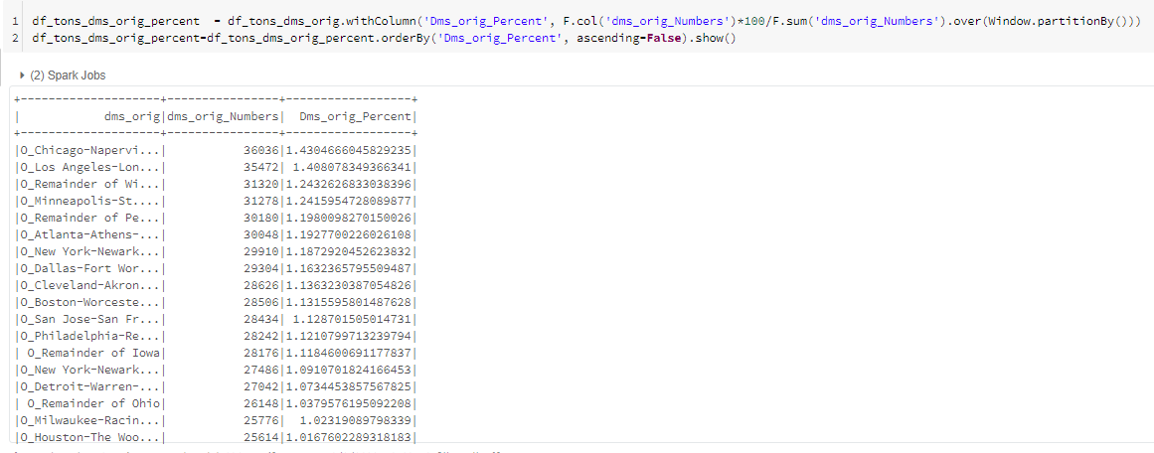

Slide 32
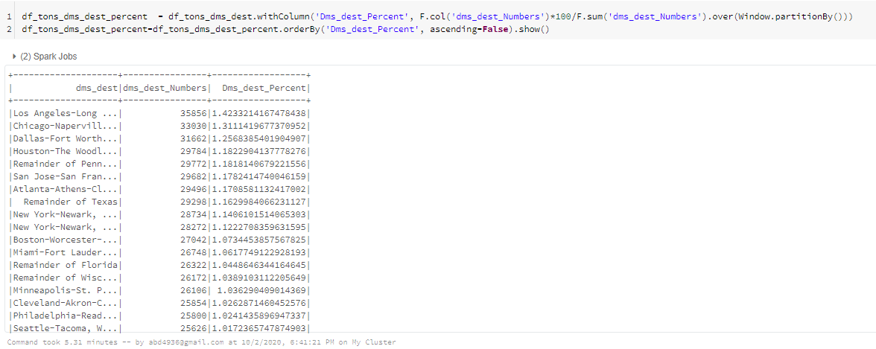

Slide 33
Domestic Freight Forecast Methodology
Forecasted U.S. Economy Database
Number of Employees
Total
By Industry
By Occupation Group
By Geographic Area
Number of Business Locations
By Industry
By Geographic Area
Geographic Segments

Slide 34
Challenge addressed by the use case
Forecasted economic dataset by industry sector and by geographic region is hard to get
FAF dataset contains 132 categorical variables of domestic destination , 132 origin destination , 43 Commodities and 7 domestic modes

Slide 35
Challenges solutions
By calculate the growth rate for each year and the previous year for it and get the average for all of these growth rates (2012 - 2018) and added it to next year.
By divide dataSet in term of domestic origin to 22 model which each model contains 6 origin out of 132 domestic origin to decrease the categorical variables.

Slide 36
Preprocessing

Slide 37
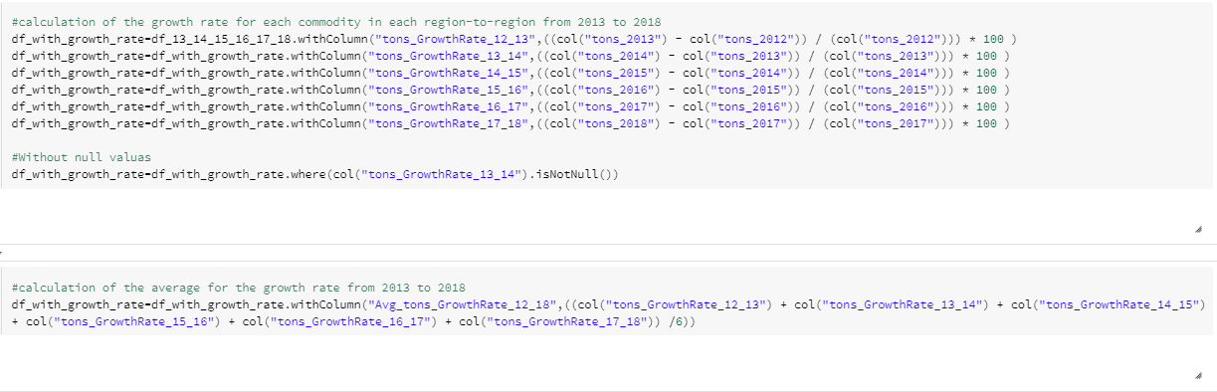

Slide 38
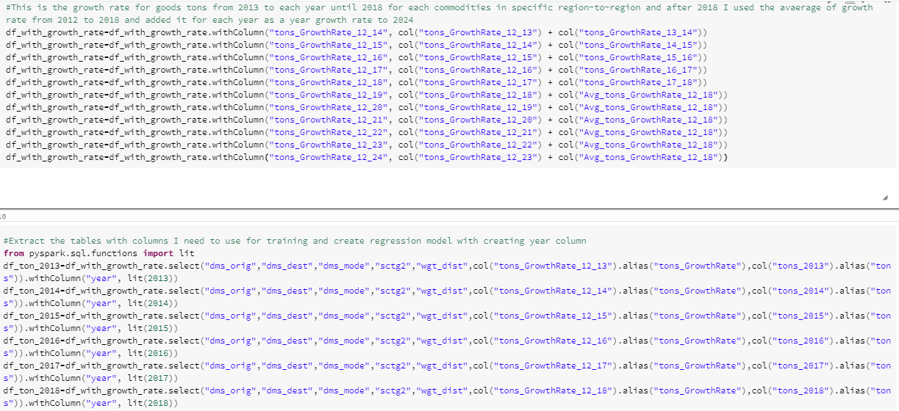

Slide 39
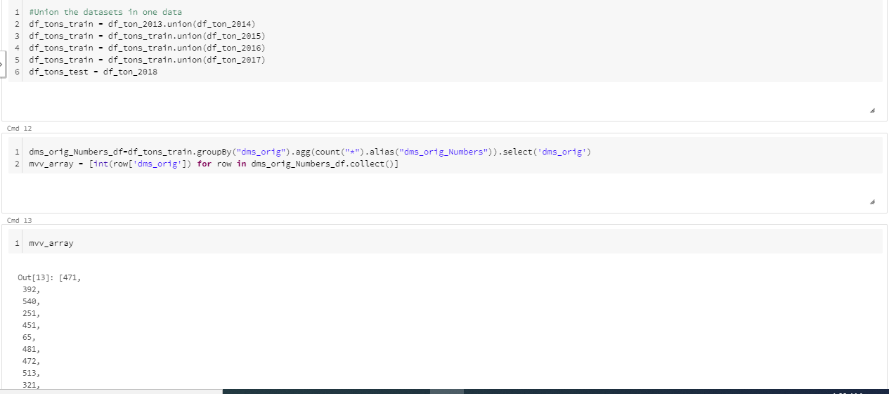

Slide 40
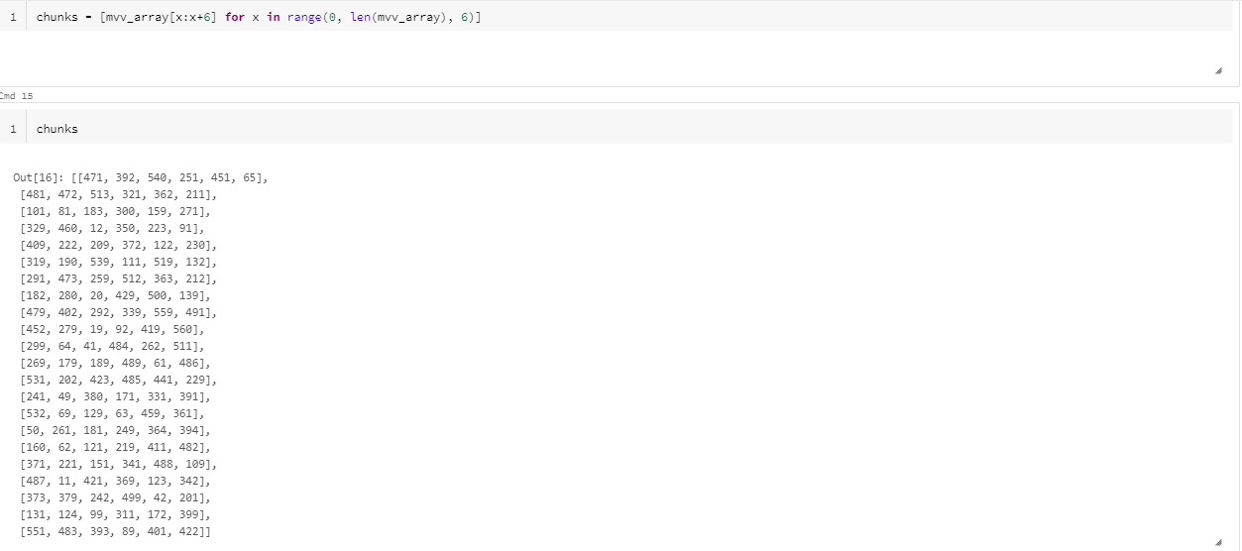

Slide 41
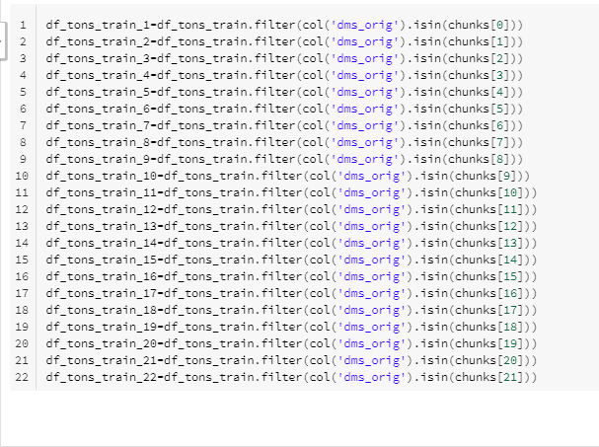

Slide 42
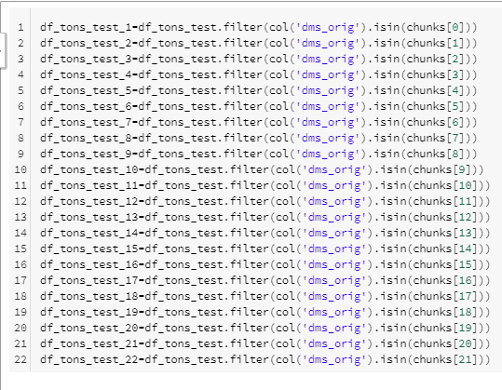

Slide 43
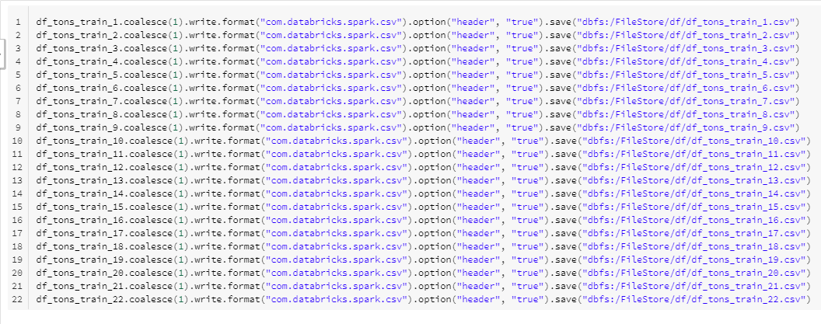

Slide 44
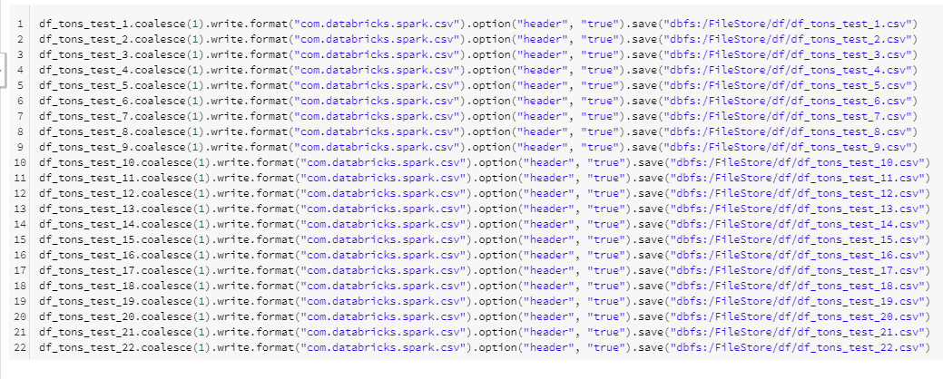

Slide 45
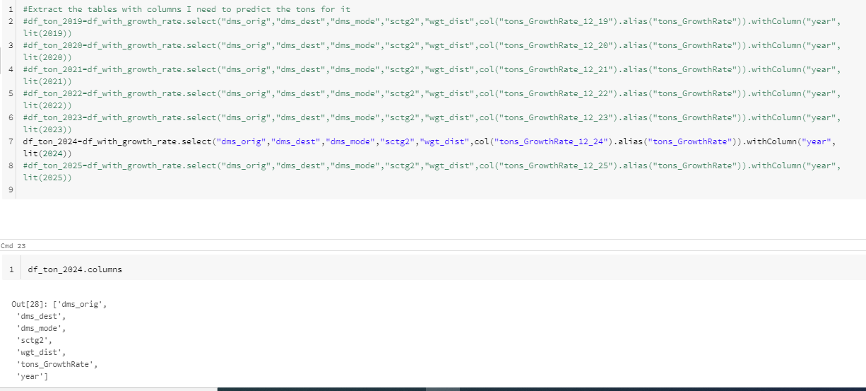

Slide 46
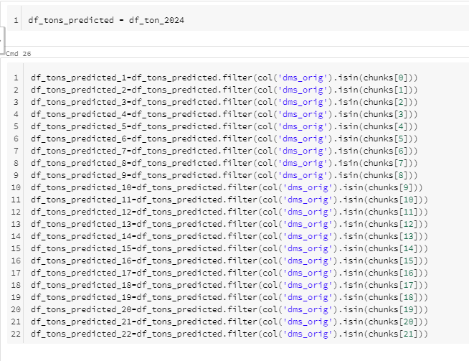

Slide 47
The Evaluations

Slide 48
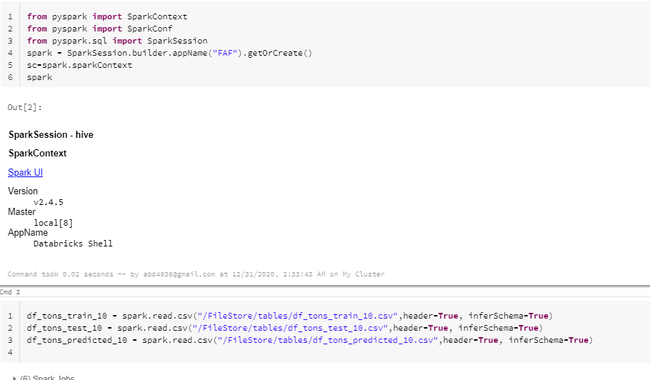

Slide 49
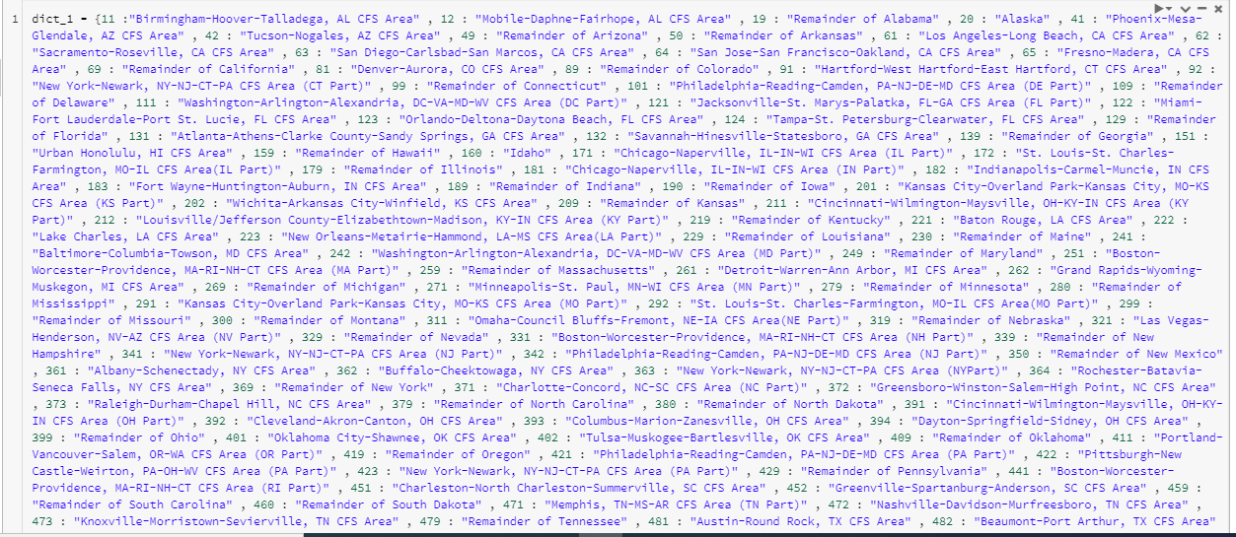

Slide 50
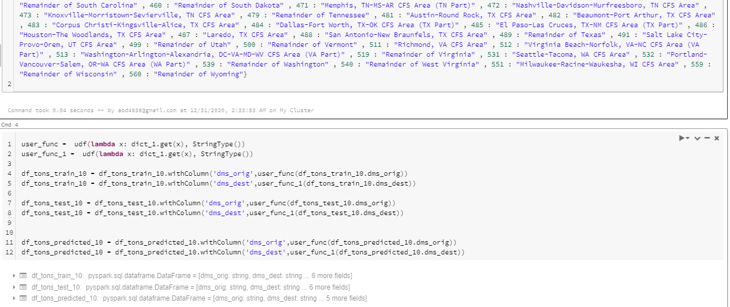

Slide 51
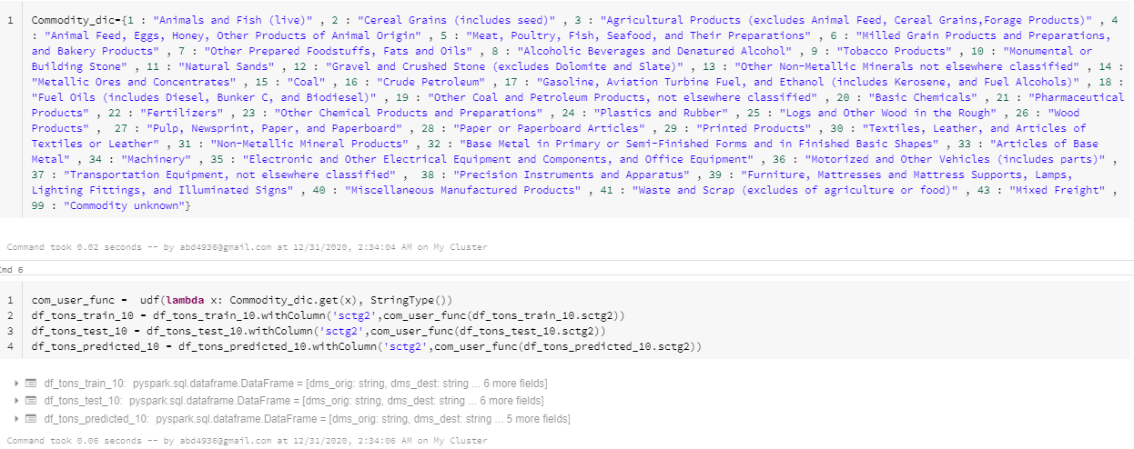

Slide 52
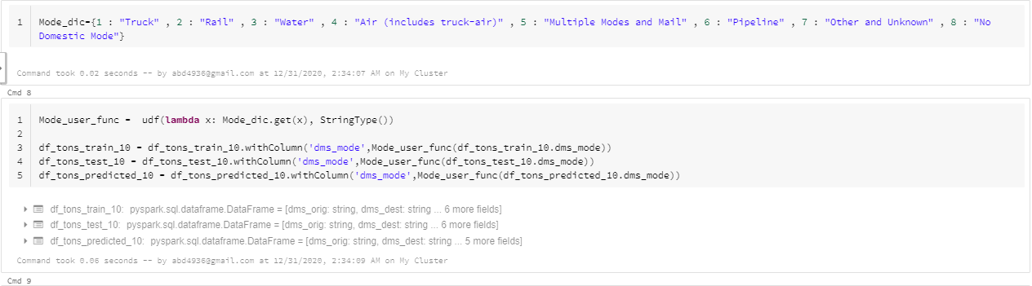

Slide 53
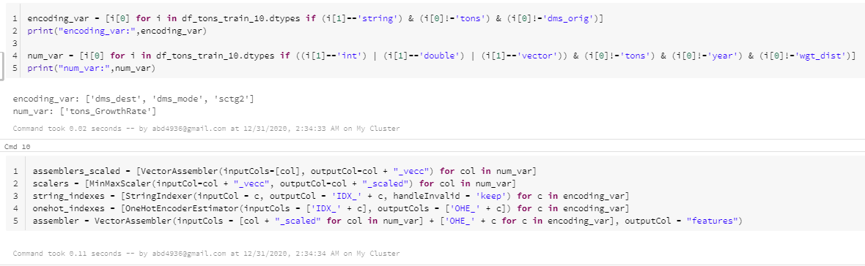

Slide 54
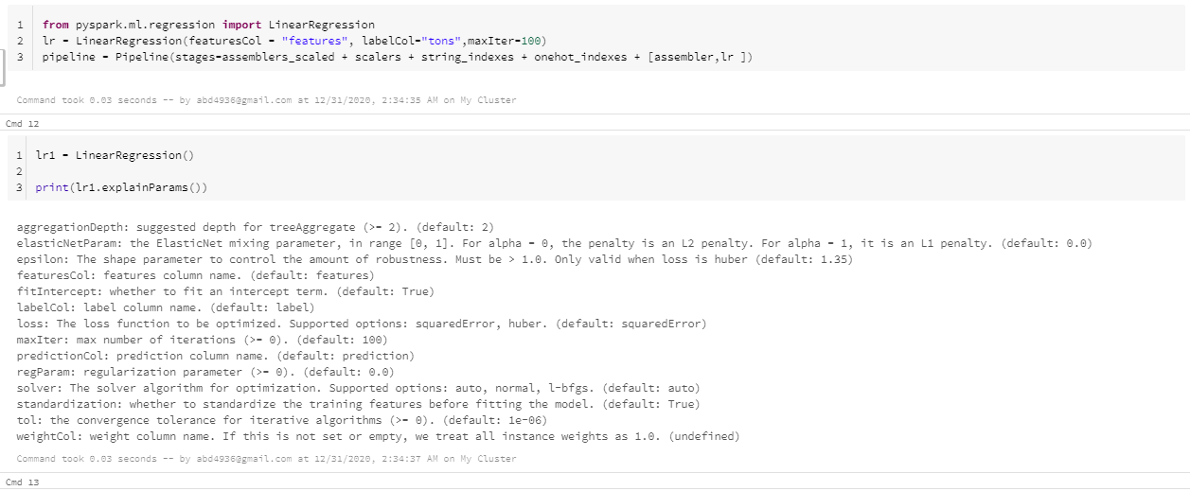

Slide 55
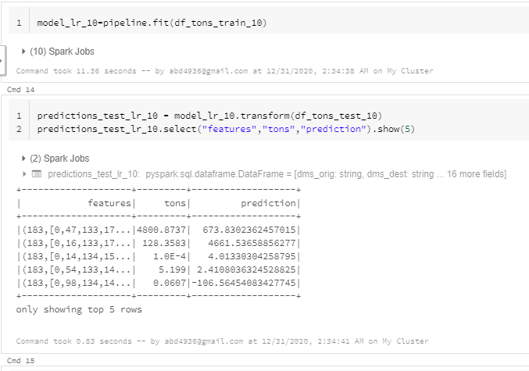

Slide 56
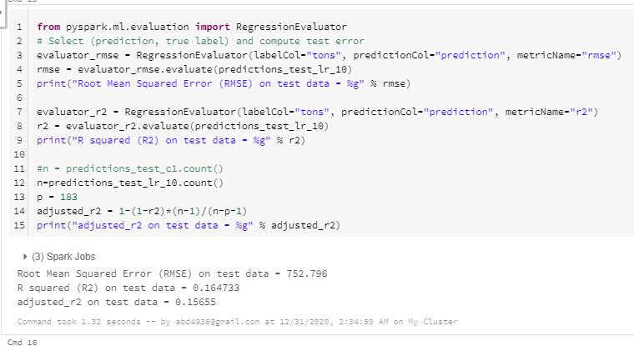

Slide 57
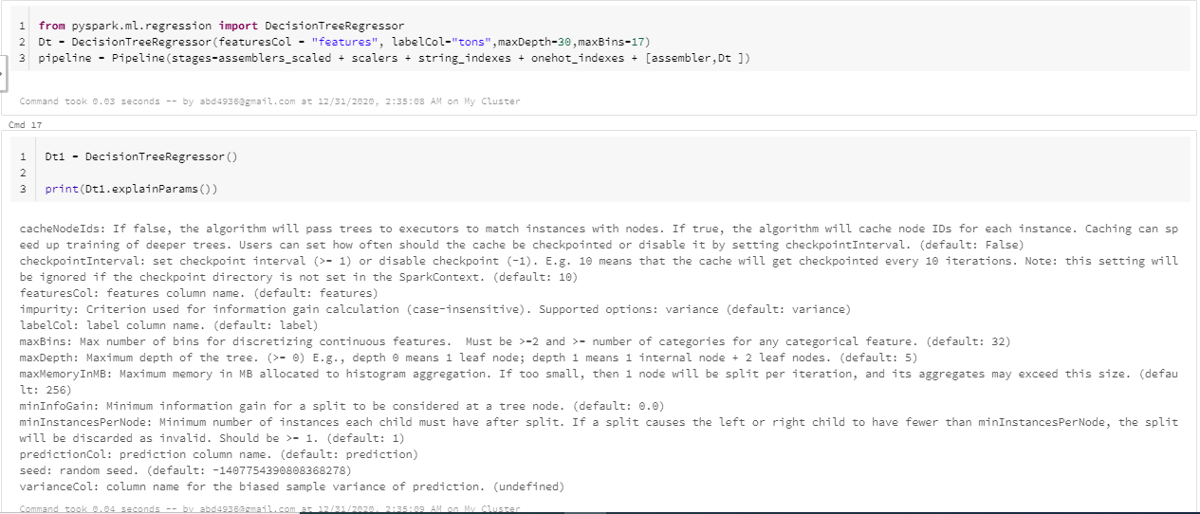

Slide 58
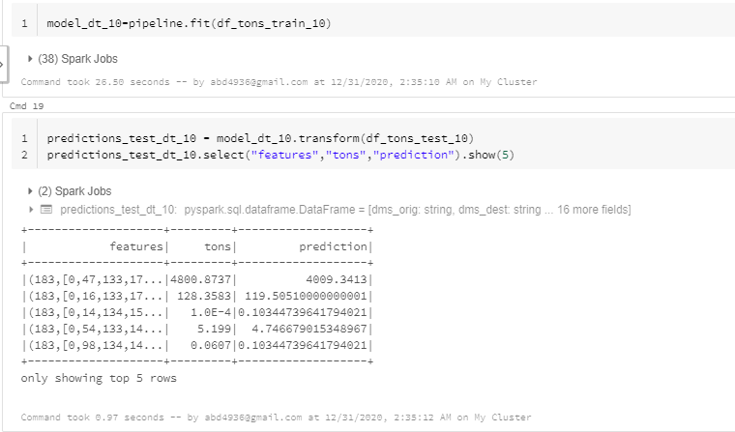

Slide 59


Slide 60


Slide 61


Slide 62


Slide 63


Slide 64


Slide 65


Slide 66


Slide 67
The Models

Slide 68


Slide 69


Slide 70


Slide 71


Slide 72


Slide 73


Slide 74


Slide 75


Slide 76


Slide 77


Slide 78


Slide 79


Slide 80


